Slide 1
Angular 17
Lesson 4—Introduction to Bootstrap
Angular 17

Slide 2

Explain Responsive Web Design (RWD)
Understand Bootstrap Grid System
Learn Bootstrap Components

Slide 3

Introduction to RWD
There was a time when User Interface (UI) was not a concern.

Slide 4
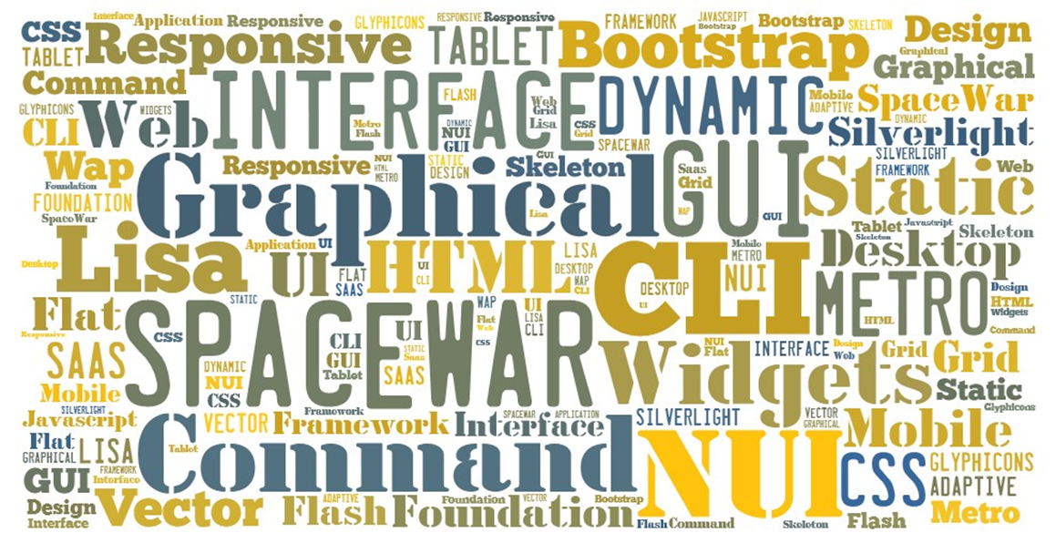
Introduction to RWD
Since 1968 , many UI innovations have happened.

Slide 5

Introduction to RWD
Many companies have successfully created excellent designs for their web applications.

Slide 6

Introduction to RWD
But today, just a unique web application screen is not enough. We need RWD.

Slide 7
Introduction to Bootstrap
Topic 1— What is Responsive Web Design (RWD)

Slide 8
What Is Responsive Web Design?
A Responsive Web Design is browser-responsive and can adapt to screens of any size.

Slide 9
Responsive vs. Adaptive
Responsive
A responsive web design is a fluid design that responds to the browser and can resize according to the screen size with no empty spaces on the sides.
Adaptive
An adaptive design adapts to the screen size only at specific points.
Responsive Web Design

Slide 10
Relative vs. Static Units
Relative units like percentages can adapt to any screen, unlike static units such as pixels.
100%
600px
170%
170%
300px
300px
Relative units
Static units

Slide 11
Flow vs. Static
The flow in a responsive web design helps the content to smoothly adjust when the screen size changes, which does not happen in static screens.
Flow
Static

Slide 12
With Breakpoints vs. Without Breakpoints
The presence of breakpoints allows you to adapt your content to the screen size when screen size changes.
With Breakpoints
Without Breakpoints

Slide 13
Vectors vs. Images
A vector adapts to the resolutions of the retina, and its quality is independent of the screen resolution.
Vector
Image

Slide 14
Mobile First
To develop a mobile-first design:
Start with CSS development for mobile device, followed by media queries to adapt to desktops and tablets.
You also need to determine the content that is most important.

Slide 15

Why Mobile First?
It will be a design independent of the screen size.
It helps avoid overwriting of code.
Millions of
mobile users worldwide
It will narrow down the website information to a convenient portion.

Slide 16
Introduction to Bootstrap
Topic 2— Bootstrap 3

Slide 17
Bootstrap
HISTORY
Bootstrap was first created at Twitter
Bootstrap 2 was released
Bootstrap 3.0 was shipped
Mid2010
January2012
August2013
August2011
February2012
Bootstrap was launched as an open source project
Bootstrap became the most starred development project of
GitHub

Slide 18


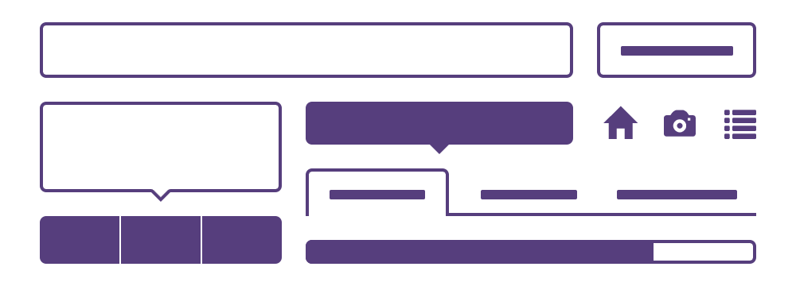
Main Features of Bootstrap
One framework for every device
Full of features
Preprocessors

Slide 19

What’s New in Bootstrap 3
New flat design
SAAS support
JavaScripts are rewritten
New powerful Grid system
New Glyphicons icon font
Mobile-first approach
New components

Slide 20





Advantages of Bootstrap 3
You can create a web application very fast
It is a natively responsive framework
It is easily and fully customizable

Slide 21
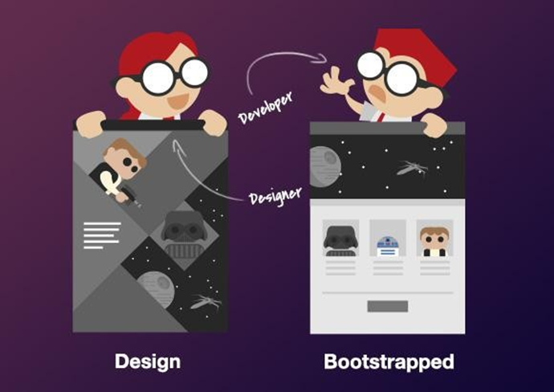


Disadvantages of Bootstrap 3
There is not much difference in the look of the website created using Bootstrap 3.
Bootstrap does not offer backward compatibility between versions.
Bootstrap 2 to Bootstrap 3

Slide 22



Competitors
Bootstrap offered by Twitter is the top front-end developing tool.
But there are other alternatives in the field.
VS.
VS.
Bootstrap
Foundation
Skeleton

Slide 23
Introduction to Bootstrap
Topic 3—Creating a Responsive Web Application

Slide 24
Responsive with Bootstrap 3
Bootstrap 3 helps you to create responsive and mobile-friendly websites easily.
It offers:
Grid system
CSS3 media queries
Responsive embed and flexible image
Responsive utilities

Slide 25

Use of @media Rule
With @media rule in Bootstrap 3, you can have a different layout for all screens, including tablet, mobile, and desktops.

Slide 26
Introduction to Grid Systems
In Bootstrap 3
Grid system permits a maximum of 12 columns in a page.
You can group and create wider columns instead of using them individually.
For decent organization and padding, place the rows within .container-fluid (full-width) or a .container (fixed-width).
Group columns into horizontal groups using rows.
Create grid columns by specifying the number of available 12 columns you wish to span.
For example, 3 equal columns would use three .col-xs-4.
Place the content within columns, and only columns may be immediate children of rows.

Slide 27
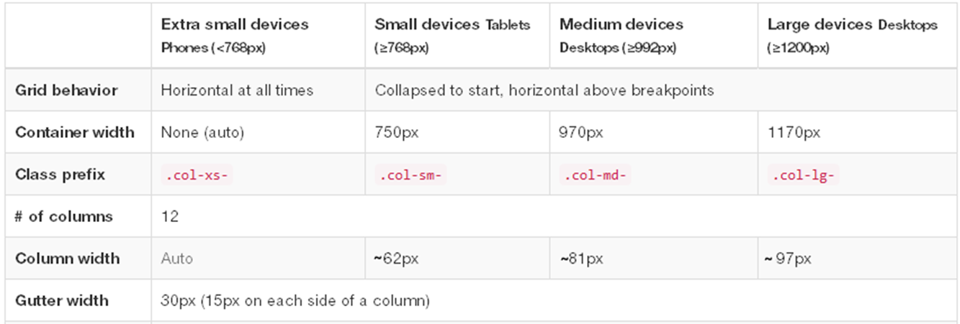
Grid System
In Bootstrap 3, the grid system presents a swift and simple way to build responsive website layouts.

Slide 28
Bootstrap Grid Classes
The Bootstrap grid system has four classes:
xs (for phones)
sm (for tablets)
md (for desktops)
lg (for larger desktops)
These classes can be combined to create more dynamic and flexible layouts.

Slide 29
Bootstrap Grid Classes
This is a basic Bootstrap grid structure :
<div class="row">
<div class="col-md-4">.col-md-4</div>
<div class="col-md-4">.col-md-4</div>
<div class="col-md-4">.col-md-4</div>
</div>

Slide 30
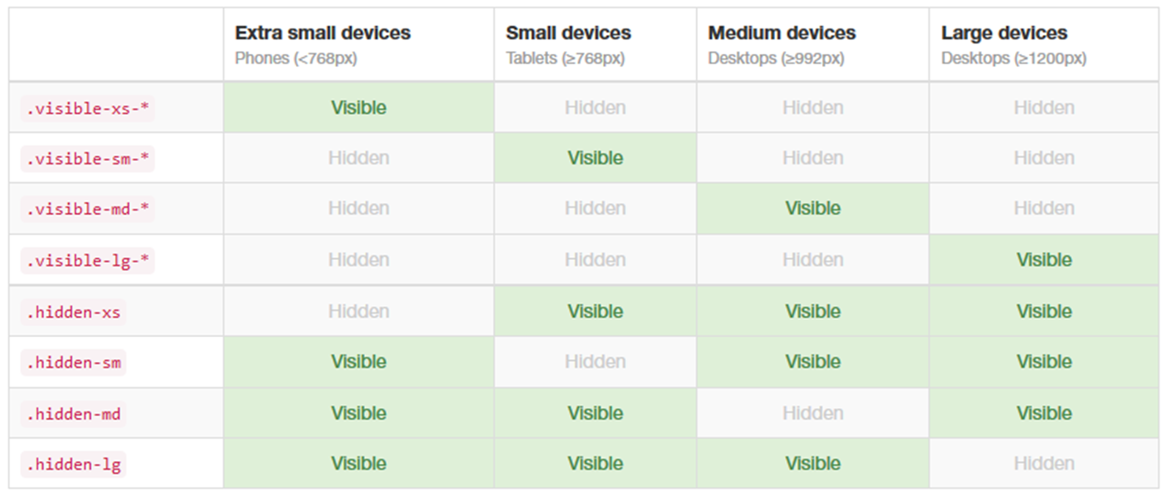
Responsive Utilities
For quick mobile-friendly development, Bootstrap offers you utility classes.

Slide 31
Bootstrap Components
Bootstrap 3 offers various components:
Labels
Panels
Jumbotron
Page Header
Navbar
Thumbnails
Alerts
List group
Page Header
Wells
Badges
Dropdowns
Button groups
Glyphicons
Button Drops
Breadcrumbs
Input groups
Navs
Pagination
Media Object

Slide 32
Step 1:Creating First Page with Bootstrap
At the start of the page, include HTML17 doctype. Also include the lang attribute and the right character set.
<!DOCTYPE html>
<html lang=“pt”>
<head>
<meta charset=“utf-8”>
<meta name=“viewport” content=“width=device-width, initial-scale=1”>
</head>
</html>

Slide 33
Step 2:Creating First Page with Bootstrap
Add the viewport <meta> tag for proper touch zooming and rendering
Adjust the width of the page and the initial zoom level per your device
This will ensure that you have a better experience, and there will be no need for zooming

Slide 34
Step 3:Creating First Page with Bootstrap
Include the following files:
bootstrap.min.css
jquery.min.js
bootstrap.min.js
Download these files and include in your page. In this example, we include them from the Internet:
<link rel=“stylesheet” href=“https://maxcdn.bootstrapcdn.com/bootstrap/3.3.7/css/bootstrap.min.css”>
<script src=“https://ajax.googleapis.com/ajax/libs/jquesry/3.1.1/jquery.min.js”></script>
<script src=“https://maxcdn.bootstrapcdn.com/ajax/bootstrap/3.3./js/bootstrap.min.js”></script>

Slide 35
Step 4:Creating First Page with Bootstrap
In Bootstrap 3, you can include elements to wrap the site contents.
<div class=“container”>
<h1>My First Bootstrap Page</h1>
<p>this is some text.</p>
</div>
<div class=“container-fluid”>
<h1>My First Bootstrap Page</h1>
<p>This is some text.</p>
</div>

Slide 36
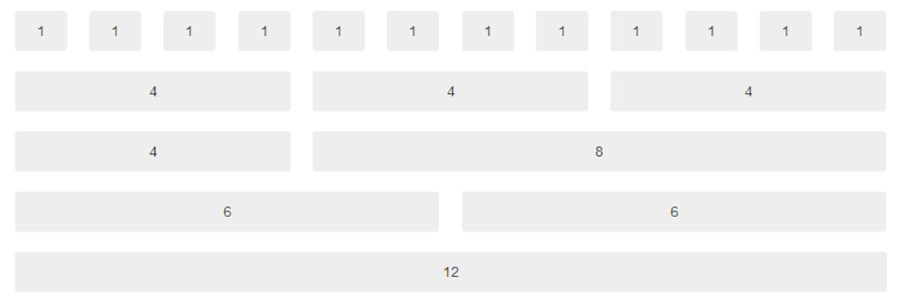
Bootstrap Grids
Grid system allows a maximum of 12 columns in a page.
Each container can be divided into rows and each row into columns with the space multiple 12.

Slide 37
Bootstrap Grids
Example:
In this example, the space inside the container is divided into a single row and the row is divided into 3 columns.
Each column has the same sides, that is, 4+4+4 = 12
Any possible combination that sums up to 12 can be used.
<div class=“container”>
<h1>Bootstrap Grid</h1>
<div class=“row”>
<div class=“col-sm-4”>.col-sm-4</div>
<div class=“col-sm-4”>.col-sm-4</div>
<div class=“col-sm-4”>.col-sm-4</div>
</div>

Slide 38
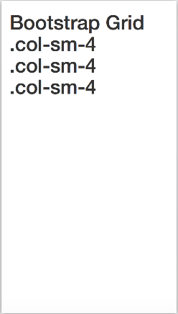
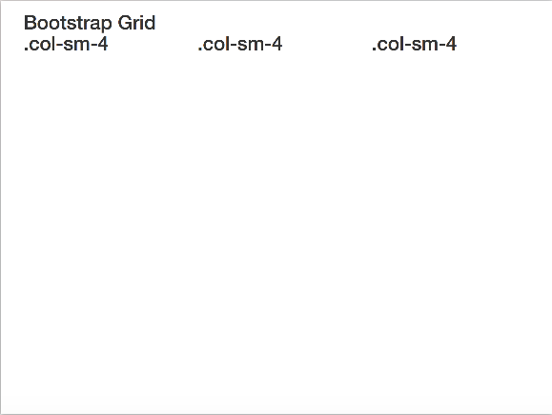
Bootstrap Grids
Output:
Here is what a responsive grid system in Bootstrap 3 with 3 columns in the page looks like:
Small Screens
Big Screens

Slide 39
Bootstrap Tables
There are four main and five contextual classes in Bootstrap 3 tables:
.table
.table-striped
.table-bordered
.table-hover
Main Classes
Contextual Classes

Slide 40
Bootstrap Tables
There are four main and five contextual classes in Bootstrap 3 tables:
.active
.success
.info
.warning
.danger
Main Classes
Contextual Classes

Slide 41
Bootstrap Tables—Example
<div class=“container”>
<h1>Bootstrap Table</h1>
<table class=“table table-stripped table-bordered table-hover”>
<thead>
<tr>
<th>Firstname</th>
<th>lastname</th>
<th>Email</th>
</tr>
</thead>
<tbody>
<tr>
<td>John</td>
<td>Doe</td>
<td>john@example.com</td>
</tr>
<tr>
<td>Joseph</td>
<td>saints</td>
<td>joseph@example.com</td>
</tr>
<tr class=“warning”>
<td>Mary Help</td>
<td>saints</td>
<td>mary@example.com</td>
</tr>
</tbody>
</table>
</div>

Slide 42
Bootstrap Tables—Example
Output:
Firstname | Lastname | Email
John | Doe | john@example.com
Joseph | Saints | joseph@example.com
Mary | Saints | mary@example.com

Slide 43
Bootstrap Images
Bootstrap 3 has three main classes for images:
. img-circle
2
. img-rounded
1
. img-thumbnail
3

Slide 44
Bootstrap Images—Example
<div class=“row”>
<div class=“col-md-4”>
<img class=“img-rounded” src=“garden-house-hotel-11.jpg” alt=“Garden” style=“width:100%”>
</div>
<div class=“col-md-4”>
<img class=“img-circle” src=“Xmas-House-17-217*2176.jpg” alt=“Snow” style=“width:100%”>
</div>
<div class=“col-md-4”>
<img class=“img-thumbnail” src=“Accomodation_image.jpg” alt=“beach” style=“width:100%”>
</div>
</div>

Slide 45
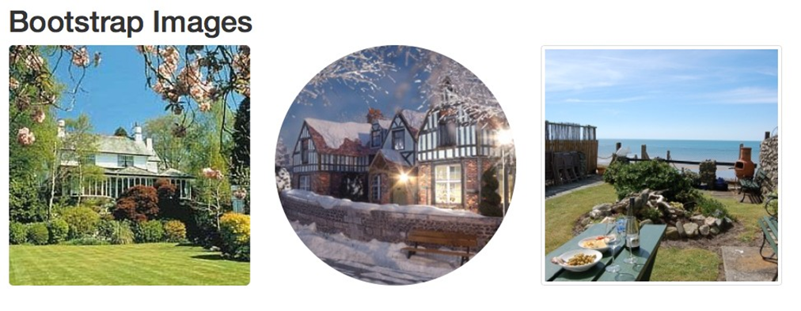
Bootstrap Images
Output:

Slide 46
Bootstrap Alerts
In Bootstrap 3, you have an easy way to create predefined alert messages using alert class, followed by one of these contextual classes.
.alert-success
.alert-info
.alert-danger
.alert-warning

Slide 47
Bootstrap Alerts—Example
<div class=“container”>
<h1>Bootstrap Alerts</h1>
<div class=“alert alert-success”>
<strong>Success!</strong> Indicates a successful or positive action.
</div>
<div class=“alert alert-info”>
<strong>Info!</strong> Indicates a neutral informative change or action.
</div>
<div class=“alert alert-warning”>
<strong>Warning!</strong> Indicates a warning that might need attention.
</div>
<div class=“alert alert-danger”>
<strong>Dnager!</strong> Indicates a dangerous or potentially negative action.
</div>
</div>

Slide 48
Bootstrap Alerts
Output:
Success! Indicates a successful or positive action.
Info! Indicates a neutral informative change or action.
Warning! Indicates a warning that might need attention.
Danger! Indicates a dangerous or potentially negative action.

Slide 49
Bootstrap Buttons
In Bootstrap 3, there are seven styles of buttons that can be created using these contextual classes:
.btn-primary
2
3
.btn-success
.btn-default
1
4
.btn-info
.btn-link
7
17
.btn-warning
6
.btn-danger

Slide 50
Bootstrap Buttons—Example
<div class=“container”>
<h1>Bootstrap Button</h1>
<button type=“button” class=“btn btn-default”>Default</button>
<button type=“button” class=“btn btn-default”>Primary</button>
<button type=“button” class=“btn btn-default”>Success</button>
<button type=“button” class=“btn btn-default”>Info</button>
<button type=“button” class=“btn btn-default”>Warning</button>
<button type=“button” class=“btn btn-default”>Danger</button>
<button type=“button” class=“btn btn-default”>Link</button>
</div>
Output:
Default
Primary
Success
Info
Warning
Danger
Link

Slide 51
Bootstrap Glyphicons
The Glyphicons Halflings set provides 260 glyphicons.
(http://getbootstrap.com/components/)

Slide 52
Bootstrap Glyphicons—Example
<div class=“container”>
<h1>Bootstrap glyphicon</h1>
<p>simple span:
<span class=“glyphicon glyphicon-check”></span>
</p>
<p>Default button with icon:
<button type=“button” class=“btn btn-default”>Play
<span class=“glyphicon glyphicon-play”></span>
</button>
</p>
<p>search icon on a styled button:
<button type=“button” class=“btn btn-info”>
<span class=“glyphicon glyphicon-search”></span> Search
</bbutton>
</p>
<p>Link with icon:
<a href=“#” class=“btn btn-success btn-lg”>
<span class=“glyphicon glyphicon-print”></span>Print
</a>
</p>
</div>

Slide 53
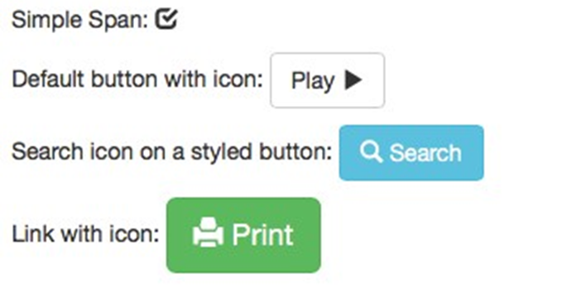
Bootstrap Glyphicons
Output:

Slide 54
Bootstrap Labels
In Bootstrap 3:
The main purpose of label is to provide information.
You can create labels with backgrounds of different colors using the .label class and one of these:
.label-danger
label-default
Contextual Classes
.label-warning
.label- primary
.label-info
.label-success

Slide 55
Bootstrap Labels—Example
<div class=“container”>
<h1>Bootstrap Label</h1>
<span class=“label label-default”>Default Label</span>
<span class=“label label-primary”>Primary Label</span>
<span class=“label label-success”>Success Label</span>
<span class=“label label-info”>Info Label</span>
<span class=“label label-warning”>Warning Label</span>
<span class=“label label-danger”>Danger Label</span>
Output:
Default Label
Primary Label
Success Label
Info Label
Warning Label
Danger Label

Slide 56

Bootstrap Panels
In Bootstrap 3, a panel is a box with a border and padding around the content.
The main purpose of the panel is to highlight or separate some information.
To create a panel, use one of the following contextual classes:
.panel-danger
6
.panel-default
1
. panel-warning
17
2
.panel-primary
4
.panel-info
3
.panel-success

Slide 57
Bootstrap Panels—Example
<div class=“container”>
<h1>Bootstrap Panel</h1>
<div class=“Panel panel-success”>
<div class=“panel-heading”>Panel heading</div>
<div class=“panel-body”>Panel Content</div>
<div class=“panel-footer”>Panel Footer</div>
</div>
Output:
Panel Heading
Panel Content
Panel Footer

Slide 58
Bootstrap Themes and Templates
Theme: A customized CSS
Template: One or more predesigned HTML pages that use a theme
Both theme and template are a collection of elements like grids, buttons, and panels that are put together to create a fully functional website/web application.
You can download several freely available templates themes.
Some templates can be downloaded from https://startbootstrap.com/template-categories/all/

Slide 59
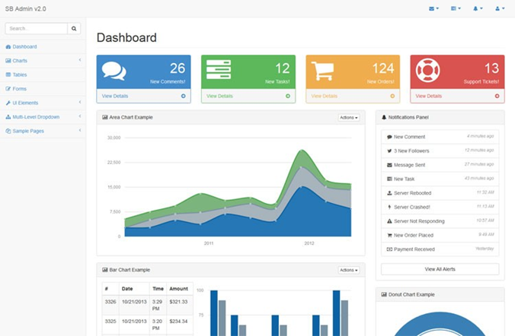
Bootstrap Themes and Templates
SB Admin 2 template is relevant for web applications. It consists of tables, forms, charts, and other components.

Slide 60
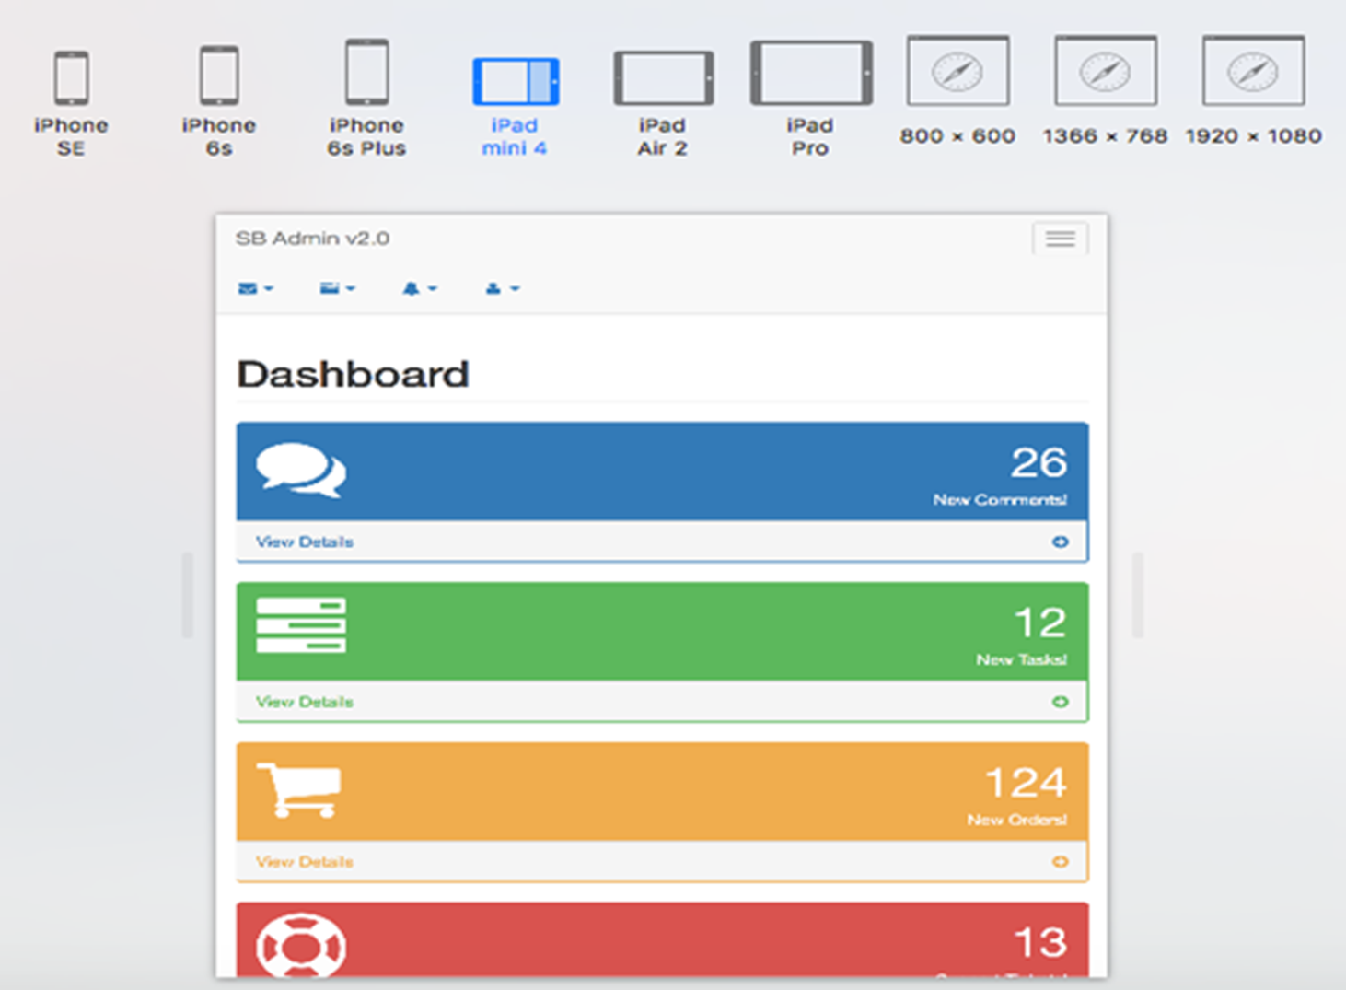
Bootstrap Themes and Templates
Download the SB Admin 2 template on your computer
Open the /pages/index.html in your web browser
Customize it or write the application design from scratch

Slide 61
A Responsive Web Design is a unique design that can adapt to any screen size.
A grid system presents a swift and simple way to build responsive website layouts.
Bootstrap 3 offers various components, including tables, images, alerts, panels, buttons, templates, themes and more that you can use to create your web design.

Slide 63
Bootstrap's grid system allows up to ____________.
1
6 columns across the page
12 columns across the page
24 columns across the page
10 columns across the page

Slide 64
Bootstrap's grid system allows up to ____________.
1
6 columns across the page
12 columns across the page
24 columns across the page
10 columns across the page
b.
Bootstrap's grid system allows up to 12 columns across the page.

Slide 65
In <meta name="viewport" content="width=device-width, initial-scale=1">the width=device-the width part sets ___________.
2
The view in Desktop only
The width of the page to follow the screen-width of the device (which will vary depending on the device)
The view for Mobile only
None of the above

Slide 66
In <meta name="viewport" content="width=device-width, initial-scale=1">the width=device-the width part sets ___________.
2
The view in Desktop only
The width of the page to follow the screen-width of the device (which will vary depending on the device)
The view for Mobile only
None of the above
b.
In <meta name="viewport" content="width=device-width, initial-scale=1">the width=device-, the width part sets the width of the page to follow the screen-width of the device (which will vary depending on the device).

Slide 67
We can create badges inside buttons.
3
True
False
Notes:
Please mention the topic this question relates to.

Slide 68
We can create badges inside buttons.
3
True
False
a
We can create badges inside buttons.

Slide 69
Which class creates a list of items?
4
lst-group
list-group
menu-group
list-grp

Slide 70
Which class creates a list of items?
4
lst-group
list-group
menu-group
list-grp
b.
list-group is the class that creates a list of items.

